Slide 1

TENSORFLOW 2.0
PRACTICAL ADVANCED

Slide 2

ANN/CNN REVIEW
(*PLEASE SKIP IF CONTENT SOUNDS FAMILIAR)

Slide 3
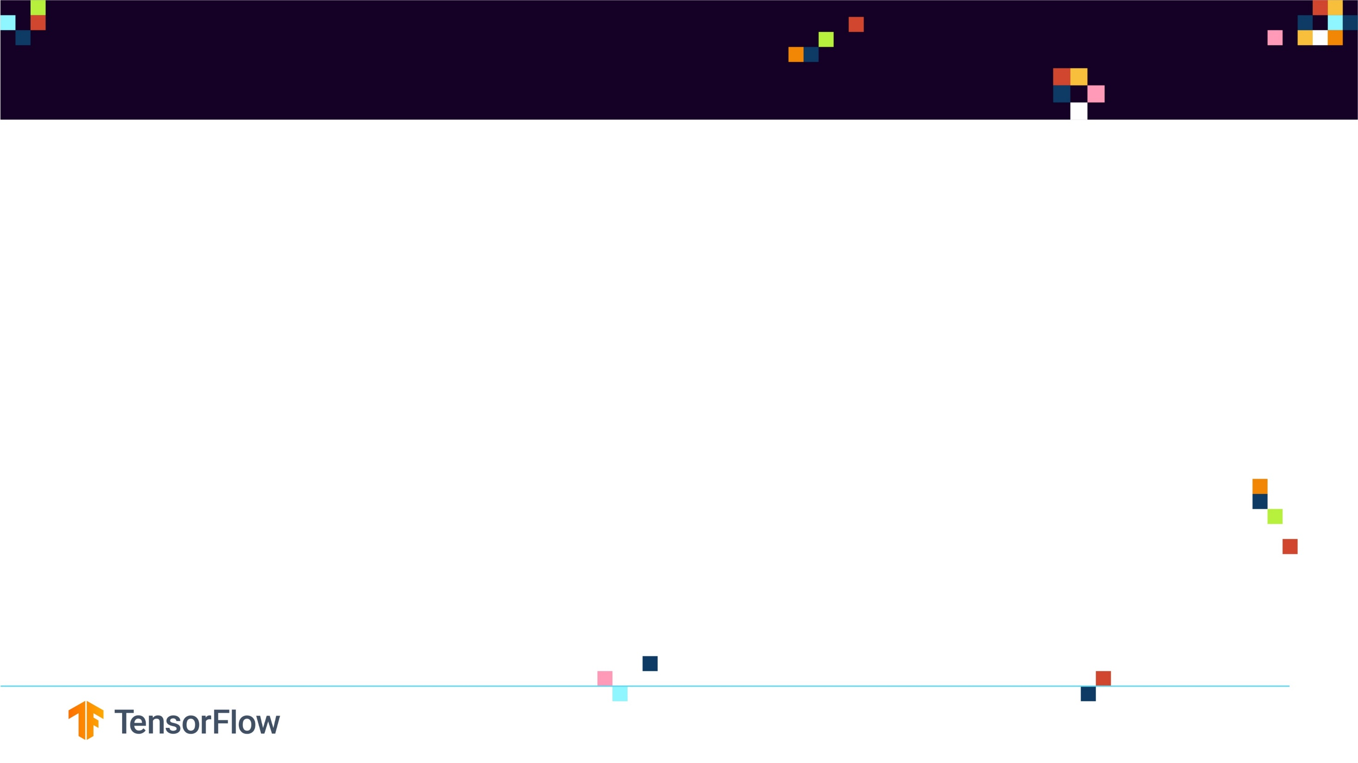
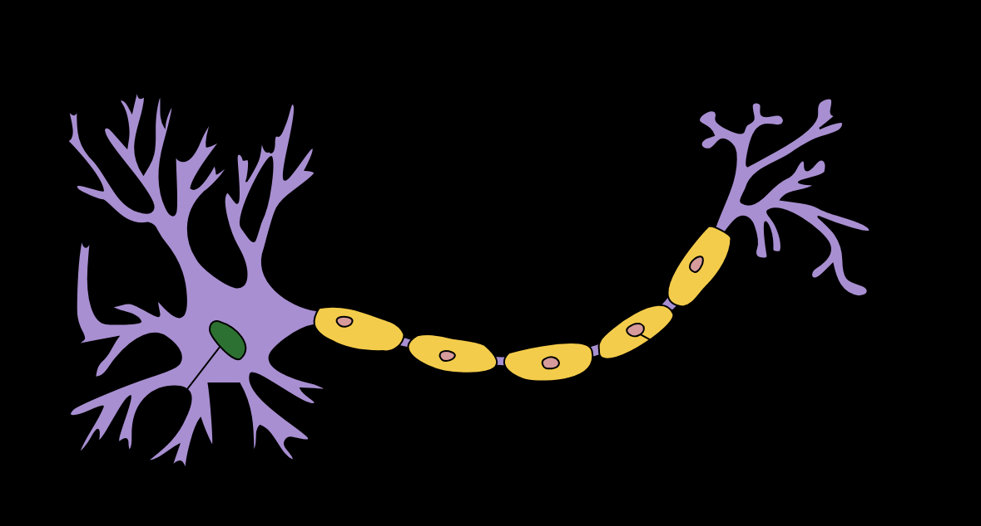
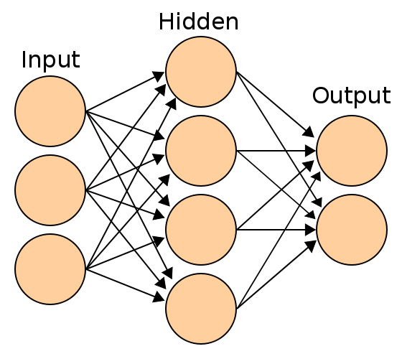
CONVOLUTIONAL NEURAL NETWORKS BASICS
The neuron collects signals from input channels named dendrites, processes information in its nucleus, and then generates an output in a long thin branch called the axon.
Human learning occurs adaptively by varying the bond strength between these neurons.
Photo Credit: https://commons.wikimedia.org/wiki/File:Artificial_neural_network.svg
Photo Credit: https://commons.wikimedia.org/wiki/File:Neuron_Hand-tuned.svg

Slide 4
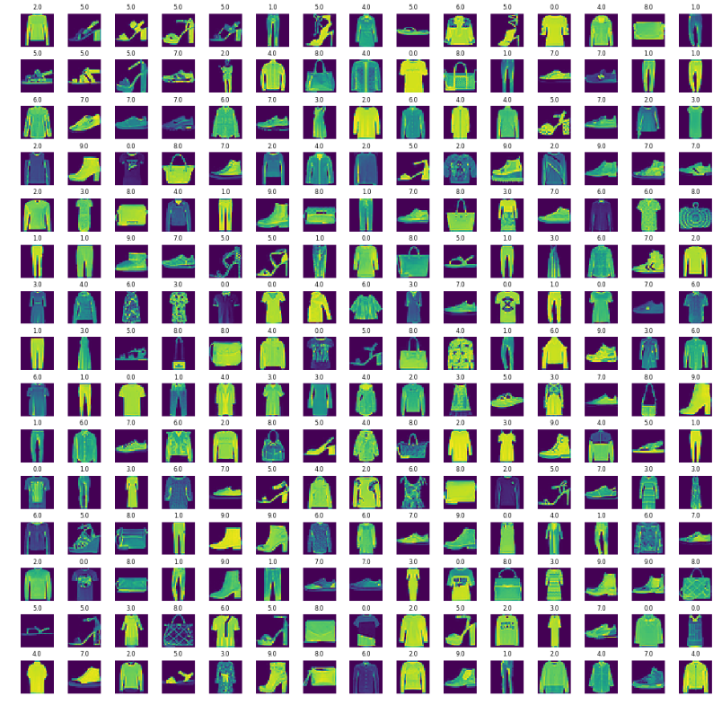
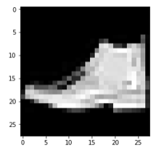
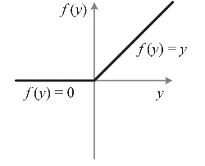
CONVOLUTIONAL NEURAL NETWORKS: ENTIRE NETWORK OVERVIEW
T-SHIRT/TOP
TROUSER
PULLOVER
DRESS
COAT
SANDAL
SHIRT
SNEAKER
BAG
ANKLE BOOT
CONVOLUTION
POOLING
FLATTENING
KERNELS/
FEATURE DETECTORS
POOLING FILTERS
CONVOLUTIONAL LAYER
POOLING LAYER (DOWNSAMPLING)
Photo Credit: https://commons.wikimedia.org/wiki/File:Artificial_neural_network.svg

Slide 5
FEATURE DETECTORS
Convolutions use a kernel matrix to scan a given image and apply a filter to obtain a certain effect.
An image Kernel is a matrix used to apply effects such as blurring and sharpening.
Kernels are used in machine learning for feature extraction to select most important pixels of an image.
Convolution preserves the spatial relationship between pixels.
FEATURE MAPS
KERNELS/
FEATURE DETECTORS

Slide 6
FEATURE DETECTORS
Live Convolution: http://setosa.io/ev/image-kernels/
FEATURE DETECTOR
0 | 1 | 1 | 0 | 1
1 | 0 | 0 | 0 | 1
1 | 1 | 0 | 0 | 0
0 | 1 | 1 | 1 | 0
0 | 0 | 1 | 0 | 1
1 | 0 | 0
0 | 1 | 0
0 | 1 | 0
1
1
1
3
1
1
2
3
1
FEATURE MAP
IMAGE

Slide 7

RELU (RECTIFIED LINEAR UNITS)
RELU Layers are used to add non-linearity in the feature map.
It also enhances the sparsity or how scattered the feature map is.
T-SHIRT/TOP
TROUSER
PULLOVER
DRESS
COAT
SANDAL
SHIRT
SNEAKER
BAG
ANKLE BOOT
CONVOLUTION
POOLING
FLATTENING
KERNELS/
FEATURE DETECTORS
POOLING FILTERS
CONVOLUTIONAL LAYER
POOLING LAYER (DOWNSAMPLING)
Photo Credit: https://commons.wikimedia.org/wiki/File:Artificial_neural_network.svg

Slide 8
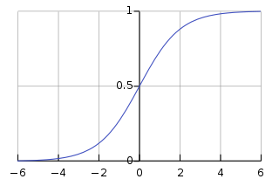

RELU (RECTIFIED LINEAR UNITS)
RELU Layers are used to add non-linearity in the feature map.
It also enhances the sparsity or how scattered the feature map is.
The gradient of the RELU does not vanish as we increase x compared to the sigmoid function
7 | 10 | -5 | 2 | 1
1 | 0 | 2 | 3 | -6
1 | 17 | -5 | 0 | 0
0 | 1 | 1 | 1 | 0
0 | 0 | -8 | 12 | 1
7 | 10 | 0 | 2 | 1
1 | 0 | 2 | 3 | 0
1 | 17 | 0 | 0 | 0
0 | 1 | 1 | 1 | 0
0 | 0 | 0 | 12 | 1
Photo Credit: https://commons.wikimedia.org/wiki/File:Artificial_neural_network.svg

Slide 9
POOLING (DOWNSAMPLING)
Pooling or down sampling layers are placed after convolutional layers to reduce feature map dimensionality.
This improves the computational efficiency while preserving the features.
Pooling helps the model to generalize by avoiding overfitting.
If one of the pixel is shifted, the pooled feature map will still be the same.
Max pooling works by retaining the maximum feature response within a given sample size in a feature map.
1 | 1 | 3 | 4
3 | 6 | 2 | 8
3 | 9 | 1 | 0
1 | 3 | 3 | 4
6
MAX POOLING
6
8
FLATTENING
8
9
4
9
2x2
STRIDE = 2
4
Photo Credit: https://commons.wikimedia.org/wiki/File:Artificial_neural_network.svg

Slide 10
CNNS IN ACTION

Slide 11
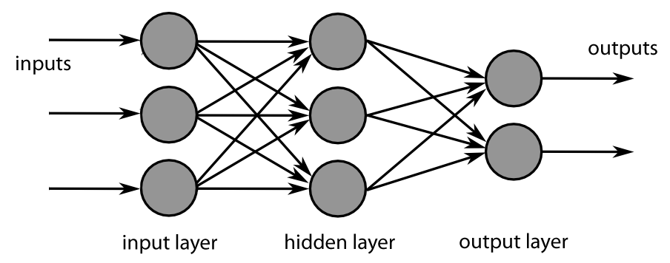
INCREASE FILTERS/DROPOUT
Live illustration : http://scs.ryerson.ca/~aharley/vis/conv/flat.html
Improve accuracy by adding more feature detectors/filters or adding a dropout.
Dropout refers to dropping out units in a neural network.
Neurons develop co-dependency amongst each other during training
Dropout is a regularization technique for reducing overfitting in neural networks.
It enables training to occur on several architectures of the neural network
KERNELS/
FEATURE DETECTORS
64 INSTEAD OF 32
Photo Credit: https://fr.m.wikipedia.org/wiki/Fichier:MultiLayerNeuralNetworkBigger_english.png

Slide 12
HOW DO ANNS TRAIN?

Slide 13
ANN TRAINING STRATEGIES
Supervised learning
Used if there is large set of test data with known labels (outputs).
The learning algorithm evaluates output ( i.e.: makes predictions), compares output against the label, and adjust network and repeat.
Unsupervised learning
Used with "unlabeled" data (not categorized) (Ex: k-means clustering).
Since learning algorithm works with unlabeled data, there is no way to assess the accuracy of the structure suggested by the algorithm
Reinforced learning
Learning algorithm takes actions that maximizes some notion of cumulative reward.
Over time, the network learns to prefer the right kind of action and to avoid the wrong one.

Slide 14
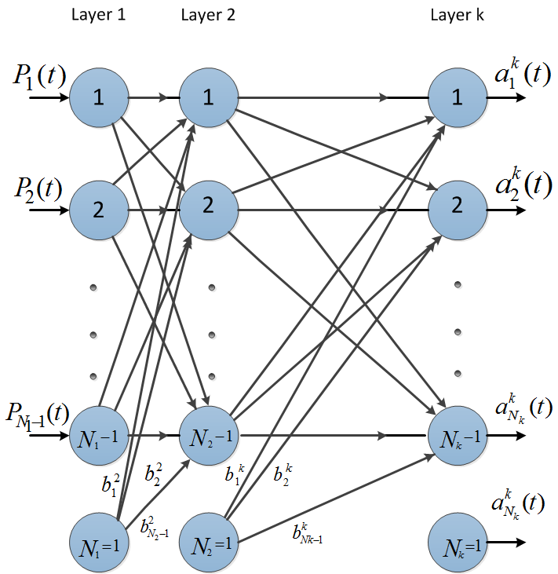


EPOCHS
Predicted
Output
$$\hat{Y}$$
Desired (True) Output Y
Testing
inputs
X
Training
inputs
X
Error = $\hat{Y}−Y$
Update Network Weights

Slide 15
DIVIDE DATA INTO TRAINING AND TESTING
Data set is generally divided into 50%, 25%, 25% segments for training, validation, and testing, respectively.
Training set: used for gradient calculation and weight update.
Validation set:
used for cross-validation which is performed to assess training quality as training proceeds.
Cross-validation is implemented to overcome over-fitting (over-training). Over-fitting occurs when algorithm focuses on training set details at cost of losing generalization ability.
Trained network MSE might be small during training but during testing, the network may exhibit poor generalization performance.
Testing set: used for testing trained network.

Slide 16
TENSORFLOW PLAYGROUND

Slide 17
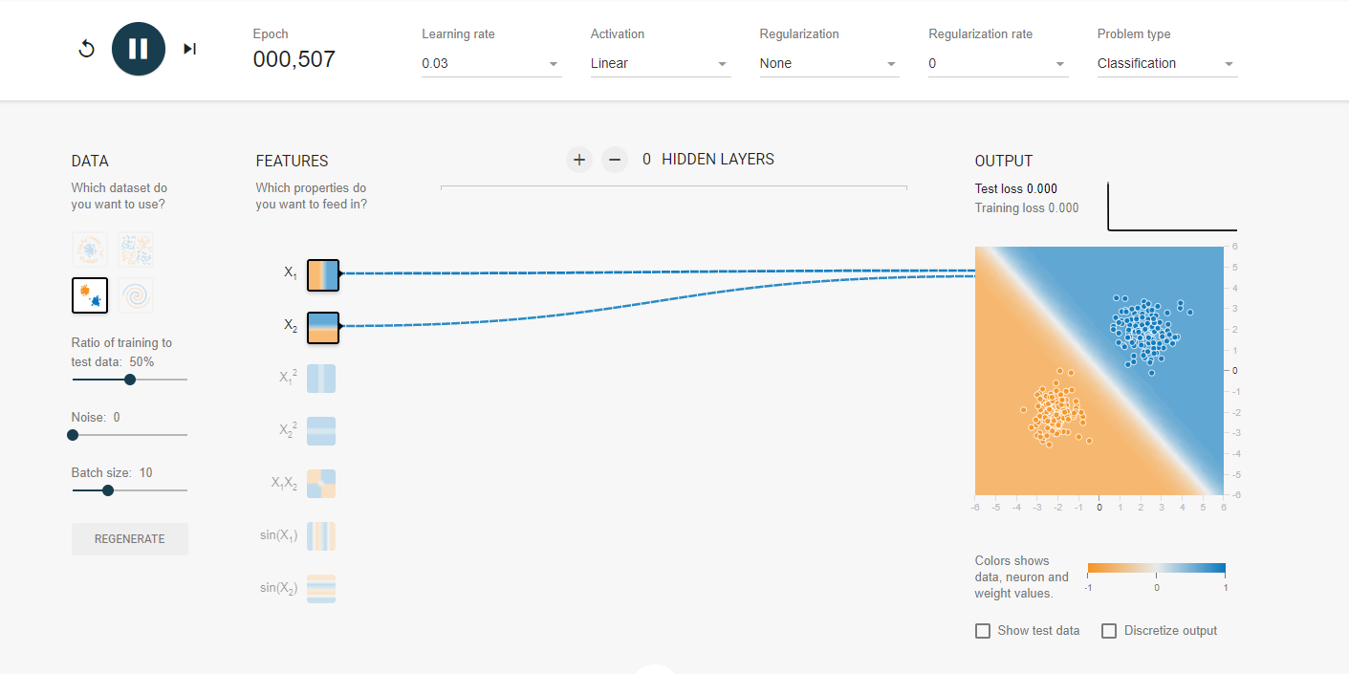
DEEP DIVE INTO TF PLAYGROUND
Check this out: https://playground.tensorflow.org

Slide 18
GRADIENT DESCENT

Slide 19
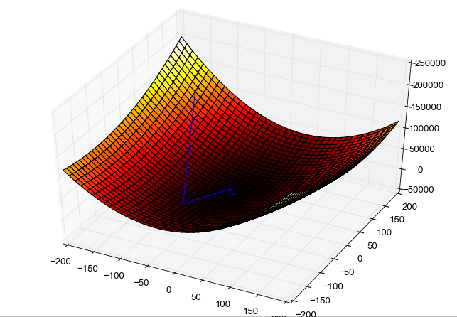
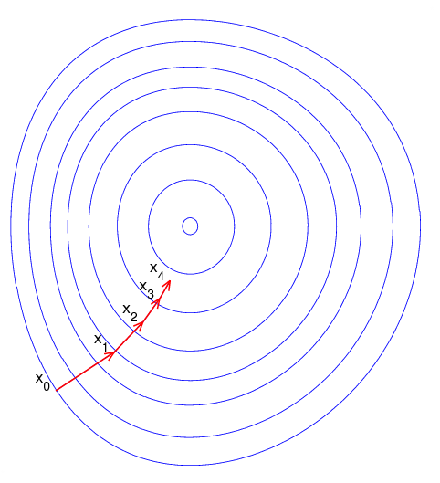
GRADIENT DESCENT
Gradient descent is an optimization algorithm used to obtain the optimized network weight and bias values
It works by iteratively trying to minimize the cost function
It works by calculating the gradient of the cost function and moving in the negative direction until the local/global minimum is achieved
If the positive of the gradient is taken, local/global maximum is achieved
Photo Credit: https://commons.wikimedia.org/wiki/File:Gradient_descent_method.png
Photo Credit: https://commons.wikimedia.org/wiki/File:Gradient_descent.png

Slide 20
LEARNING RATE
The size of the steps taken are called the learning rate
If learning rate increases, the area covered in the search space will increase so we might reach global minimum faster
However, we can overshoot the target
For small learning rates, training will take much longer to reach optimized weight values

Slide 21


GRADIENT DESCENT
Gradient descent works as follows:
Calculate the derivative (gradient) of the Loss function
Pick random values for parameters m, b and substitute
Calculate the step size (how much are we going to update the parameters?)
$Step size = Slope ∗ learning rate$
4. Update the parameters and repeat
OPTIMAL POINT
GLOBAL MINIMUM
Sum of Squared Residuals
$$y=b+m∗x$$
GOAL IS TO FIND
BEST PARAMETERS
*Note: in reality, this graph is 3D and has three axes, one for m, b and sum of squared residuals
Parameters (m, b)

Slide 22

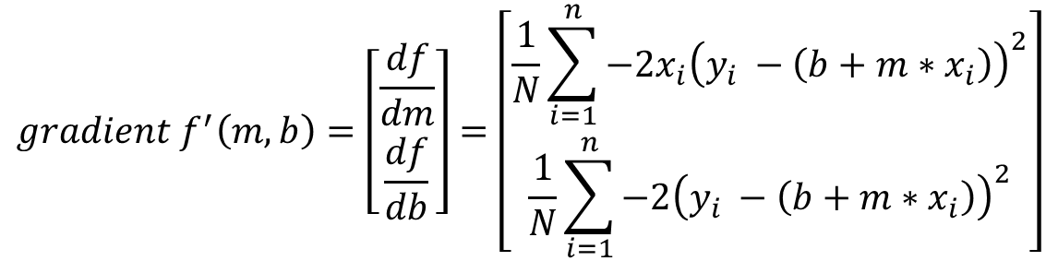
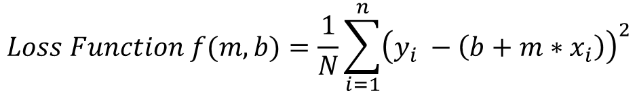
GRADIENT DESCENT MATH!
$$y=b+m∗x$$
GOAL IS TO FIND
BEST PARAMETERS
$$Loss Function f(m,b)=\frac{1}{N}\sum_{i=1}^{n}{{\left(y_{i} −\left(b+m∗x_{i}\right)\right)}^{2}}$$
OPTIMAL POINT
GLOBAL MINIMUM
$$gradient f^{′}\left(m,b\right)=\left[\begin{matrix}\frac{df}{dm} \\ \frac{df}{db}\end{matrix}\right]=\left[\begin{matrix}\frac{1}{N}\sum_{i=1}^{n}{−2x_{i}{\left(y_{i} −\left(b+m∗x_{i}\right)\right)}^{2}} \\ \frac{1}{N}\sum_{i=1}^{n}{−2{\left(y_{i} −\left(b+m∗x_{i}\right)\right)}^{2}}\end{matrix}\right]$$
Sum of Squared Residuals (Loss Function)
Parameters (m, b)
*Note: in reality, this graph is 3D and has three axes, one for m, b and sum of squared residuals

Slide 23
BACKPROPAGATION

Slide 24
BACK PROPAGATION
Backpropagation is a method used to train ANNs by calculating gradient needed to update network weights.
It is commonly used by the gradient descent optimization algorithm to adjust the weight of neurons by calculating the gradient of the loss function.
STEP 1: FORWARD PROPAGATION
STEP 2: ERROR CALCULATION
STEP 4: WEIGHT UPDATE
STEP 3: BACK PROPAGATION

Slide 25
BACK PROPAGATION
Backpropagation Phase 1: propagation
Propagation forward through the network to generate the output value(s)
Calculation of the cost (error term)
Propagation of output activations back through network using training pattern target in order to generate the deltas (difference between targeted and actual output values)
STEP 1: FORWARD PROPAGATION
STEP 2: ERROR CALCULATION
STEP 4: WEIGHT UPDATE
STEP 3: BACK PROPAGATION

Slide 26
BACK PROPAGATION
Phase 2: weight update
Calculate weight gradient.
A ratio (percentage) of the weight's gradient is subtracted from the weight.
This ratio influences the speed and quality of learning and called learning rate. The greater the ratio, the faster neuron train, but lower ratio, more accurate the training is.
STEP 1: FORWARD PROPAGATION
STEP 2: ERROR CALCULATION
STEP 4: WEIGHT UPDATE
STEP 3: BACK PROPAGATION

Slide 27
BACK PROPAGATION ADDITIONAL READING MATERIAL
“Backpropagation neural networks: A tutorial” by Barry J.Wythoff
“Improved backpropagation learning in neural networks with windowed momentum”, International Journal of Neural Systems, vol. 12, no.3&4, pp. 303-318.

Slide 28
BIAS VARIANCE TRADE-OFF AND OVER-FITTING

Slide 29
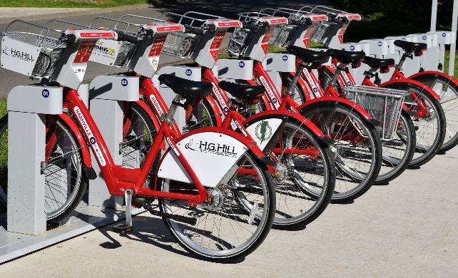
BIAS VARIANCE INTUITION
Let’s assume that we want to get the relationship between the Temperature and Bike rental usage.
As temperature experience increase, the bike rental usage tend to increase as well.
As temperature goes beyond a certain limit, usage tend to plateau and it does not increase anymore.
PERFECT (TRUE) MODEL!
BIKE USAGE
TEMPERATURE
Image Source: https://pixabay.com/photos/bike-rental-bikes-rent-pay-2284380/

Slide 30
BIAS VARIANCE TRAINING VS. TESTING DATASETS
Dataset is divided to training and testing datasets
Testing datasets have never been seen by the model before
BIKE RENTAL USAGE
TESTING DATASET
TRAINING DATASET
TEMPERATURE

Slide 31
BIAS AND VARIANCE: TRAINING VS. TESTING DATASETS
Dataset is divided to training and testing datasets
Testing datasets have never been seen by the model before
BIKE RENTAL USAGE
TESTING DATASET
TRAINING DATASET
TEMPERATURE

Slide 32
BIAS AND VARIANCE: MODEL #1– LINEAR REGRESSION (SIMPLE)
Linear Regression model uses a straight line to fit the training dataset
Linear regression model lacks flexibility so it cannot properly fit the data (as the true perfect model does!)
The linear model has a large “bias” which indicates that the model is unable to accurately capture the true relationship between temperature and rental usage.
PERFECT (TRUE) MODEL!
BIKE RENTAL USAGE
LINEAR REGRESSION MODEL
TRAINING DATASET
TEMPERATURE

Slide 33
BIAS AND VARIANCE: MODEL #2 – HIGH ORDER POLYNOMIAL REGRESSION (COMPLEX)
PERFECT (TRUE) MODEL!
High order polynomial model is able to have a very small bias and can perfectly fit the training dataset.
High-order polynomial model is very flexible
BIKE RENTAL USAGE
HIGH ORDER POLYNOMIAL MODEL
TRAINING DATASET
TEMPERATURE

Slide 34


BIAS AND VARIANCE: MODEL #1 Vs. MODEL #2 DURING TRAINING
PERFECT (TRUE) MODEL!
PERFECT (TRUE) MODEL!
RENTAL USAGE
RENTAL USAGE
LINEAR REGRESSION MODEL
HIGH ORDER POLYNOMIAL MODEL
TEMPERATURE
TEMPERATURE
SUM OF SQUARES (LARGE)
SUM OF SQUARES (SMALL ~0)
THIS IS NOT THE WHOLE STORY!!

Slide 35
BIAS AND VARIANCE: MODEL #1 Vs. MODEL #2 DURING TESTING
PERFECT (TRUE) MODEL!
PERFECT (TRUE) MODEL!
RENTAL USAGE
RENTAL USAGE
LINEAR REGRESSION MODEL
HIGH ORDER POLYNOMIAL MODEL
TEMPERATURE
TEMPERATURE
SUM OF SQUARES (SMALL)
SUM OF SQUARES (LARGE)
The polynomial model performs poorly on the testing dataset and therefore it has large variance

Slide 36
MODEL COMPLEXITY VS. ERROR
OPTIMUM MODEL
Regularization works by reducing the variance at the cost of adding some bias to the model.
A trade-off between variance and bias occurs
TOTAL ERROR
VARIANCE
ERROR
BIAS
MODEL COMPLEXITY
LINEAR
POLYNOMIAL

Slide 37
MODEL COMPLEXITY VS. ERROR
MODEL #1 (LINEAR REGRESSION) (SIMPLE) | MODEL #2 (HIGH ORDER POLYNOMIAL) (COMPLEX)
Model has High bias because it is very rigid (not flexible) and cannot fit the training dataset well | Model has small bias because it is flexible and can fit the training dataset very well.
Has small variance (variability) because it can fit the training data and the testing data with similar level (the model is able to generalize better) and avoids overfitting | Has large variance (variability) because the model over fitted the training dataset and it performs poorly on the testing dataset
Performance is consistent between the training dataset and the testing dataset | Performance varies greatly between the training dataset and the testing dataset (high variability)
Good generalization | Over fitted
Variance measures the difference in fits between the training dataset and the testing dataset
If the model generalizes better, the model has small variance which means the model performance is consistent among the training and testing datasets
If the model over fits the training dataset, the model has large variance
PERFECT REGRESSION MODEL SHALL HAVE SMALL BIAS AND SMALL VARIABILITY!
A TRADEOFF BETWEEN THE BIAS AND VARIANCE SHALL BE PERFORMED FOR ULTIMATE RESULTS

Slide 38
CLASSIFICATION MODELS KEY PERFORMANCE INDICATORS (KPIs)

Slide 39
CONFUSION MATRIX
TRUE CLASS
+
-
TYPE I ERROR
+
TRUE +
FALSE +
PREDICTIONS
FALSE -
TRUE -
-
TYPE II ERROR

Slide 40
CONFUSION MATRIX
A confusion matrix is used to describe the performance of a classiﬁcation model:
True positives (TP): cases when classiﬁer predicted TRUE (they have the disease), and correct class was TRUE (patient has disease).
True negatives (TN): cases when model predicted FALSE (no disease), and correct class was FALSE (patient do not have disease).
False positives (FP) (Type I error): classiﬁer predicted TRUE, but correct class was FALSE (patient did not have disease).
False negatives (FN) (Type II error): classiﬁer predicted FALSE (patient do not have disease), but they actually do have the disease

Slide 41
KEY PERFORMANCE INDICATORS (KPI)
Classiﬁcation Accuracy = (TP+TN) / (TP + TN + FP + FN)
Misclassiﬁcation rate (Error Rate) = (FP + FN) / (TP + TN + FP + FN)
Precision = TP/Total TRUE Predictions = TP/ (TP+FP) (When model predicted TRUE class, how often was it right?)
Recall = TP/ Actual TRUE = TP/ (TP+FN) (when the class was actually TRUE, how often did the classiﬁer get it right?)

Slide 42
PRECISION Vs. RECALL EXAMPLE
TRUE CLASS
+
-
TP = 1
FP = 1
+
PREDICTIONS
-
FN = 8
TN = 90
Classiﬁcation Accuracy = (TP+TN) / (TP + TN + FP + FN) = 91%
Precision = TP/Total TRUE Predictions = TP/ (TP+FP) = ½=50%
Recall = TP/ Actual TRUE = TP/ (TP+FN) = 1/9 = 11%

